Slide 1
“This statement that water is the next oil is a profound underestimation.
You can live without oil.
You can’t live without water.”
Inventor Dean Kamen

Slide 3
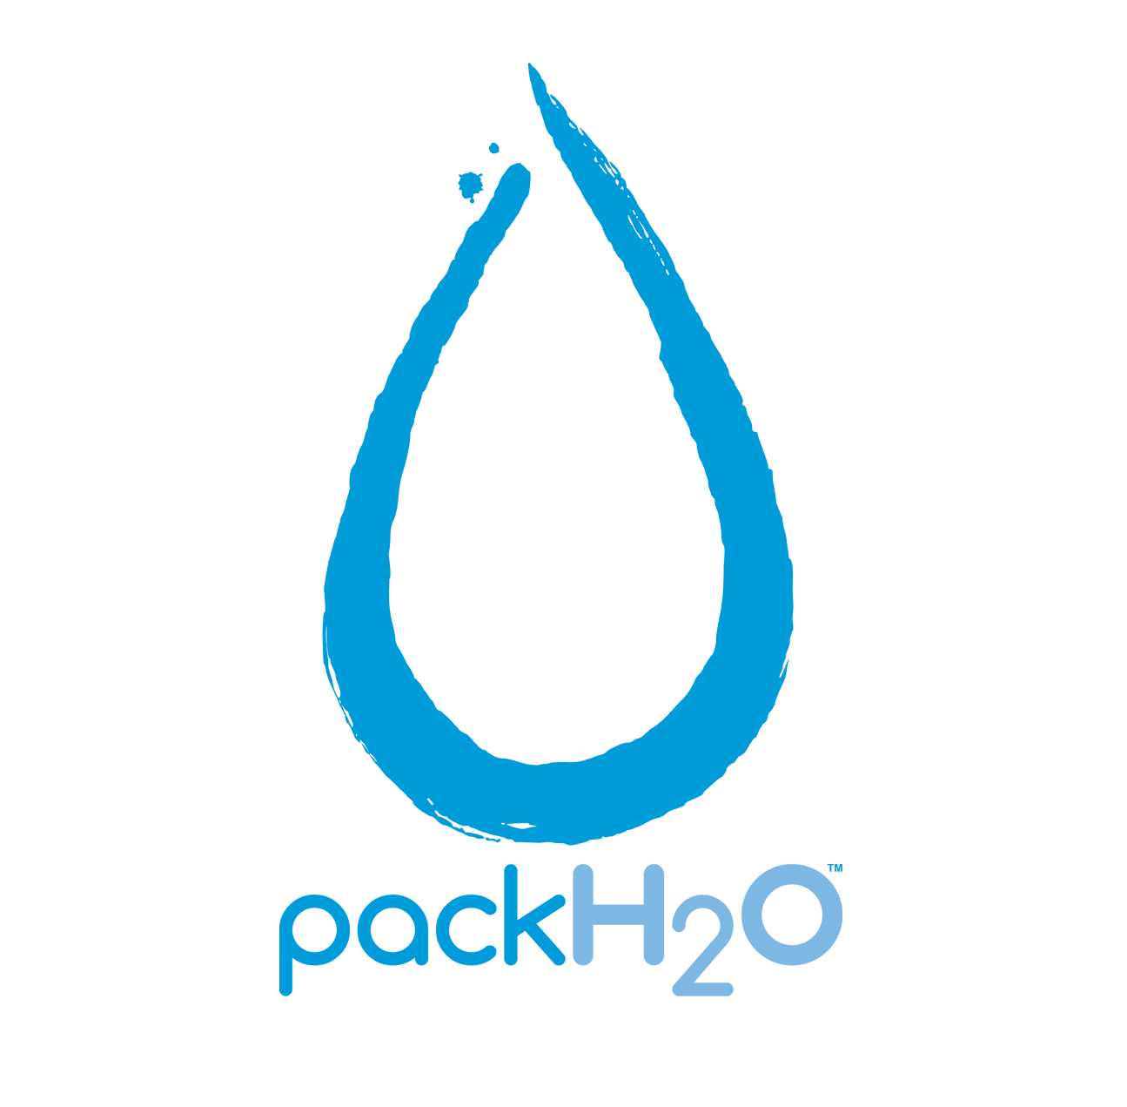
Soon supply will not meet demand
Agricultural water consumption is expected to increase 19%
(Source: UN Water stats)
50%
40%
35%
more
more
more
energy
water
food
By 2035, global energy consumption will increase 35% … increasing water consumption by 85%
Agricultural water consumption is expected to increase 19%
Source: PwC Megatrends

Slide 4
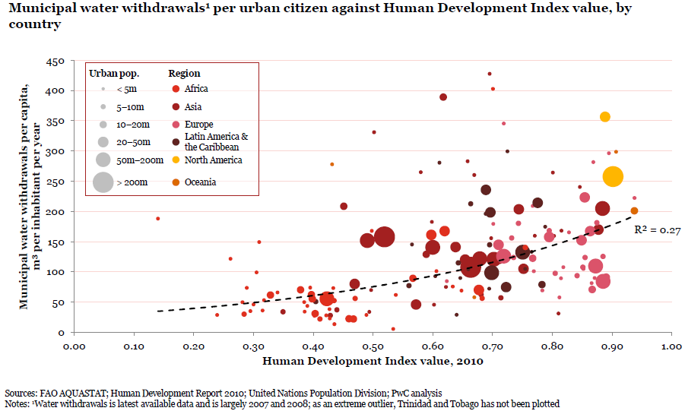
With development there is an increase in water consumption
Source: PwC Project Blue

Slide 5
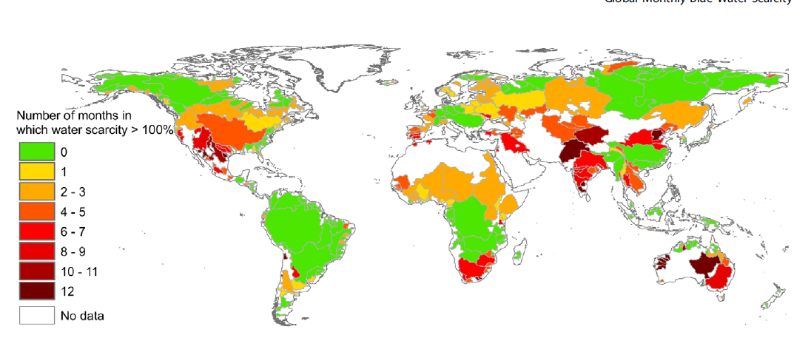
2.7 billion people experience severe
water scarcity at least one month a year
Source: Water Footprint Network, 2012

Slide 6
One in seven people does not have
access to clean water
One in seven people does not have access to clean water
Source: WWF-DEG Water Risk Filter 2012

Slide 7
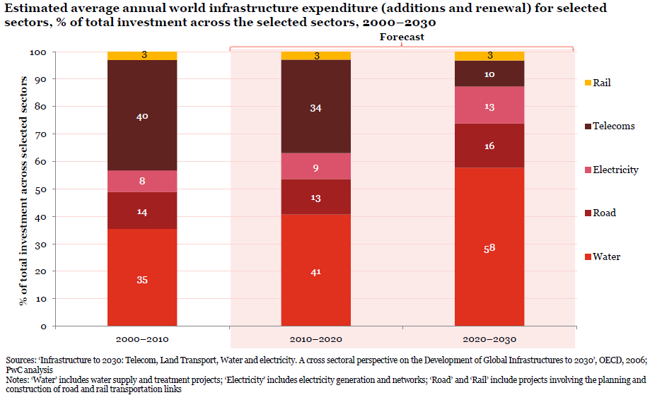
Water will become the focus for future infrastructure projects
Source: PwC Project Blue

Slide 8
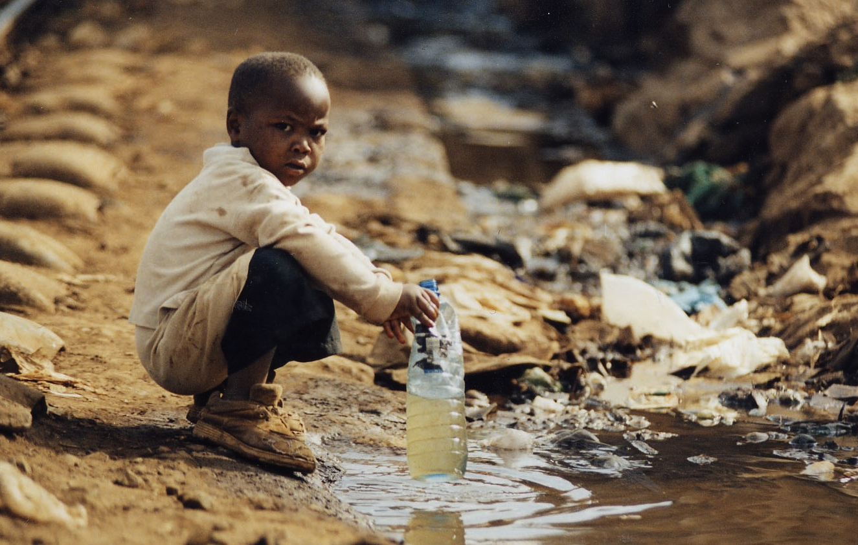
When its people are sick, a country cannot succeed.
Water borne-illnesses steal time,energy and livelihoods from people who don’t have access to clean water.
Notes:
We live in a global economy and one of our countries is weak, all of them are weak. Tony’s notes-I might suggest changing “clean water” to “safe water”

Slide 9
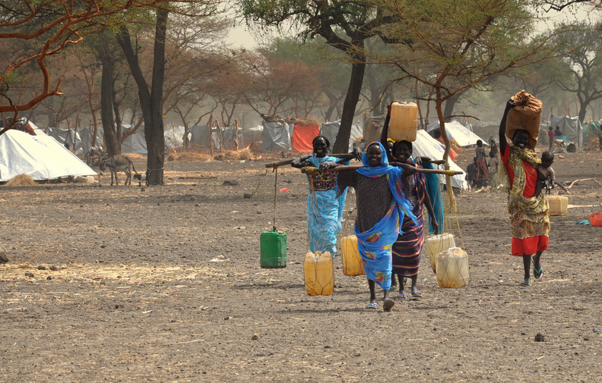
A 2O liter bucket filled with water weighs nearly 45 lbs.
.
Image © Oxfam
Notes:
David and Scott watch as that clean water was being poured into containers that clearly held gasoline and other contaminants at one point. This was there ah ha moment.

Slide 10
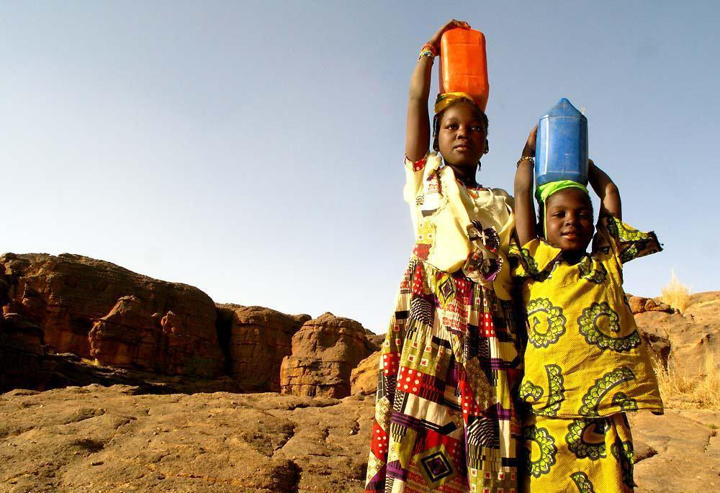
Today… 2OO million hours will be spent carrying water from source to home, often over long distances, mostly by women and children.
Image © http://wandermelon.com/
Notes:
briefly tell the story of the earthquake in haiti and greif building a well.

Slide 11
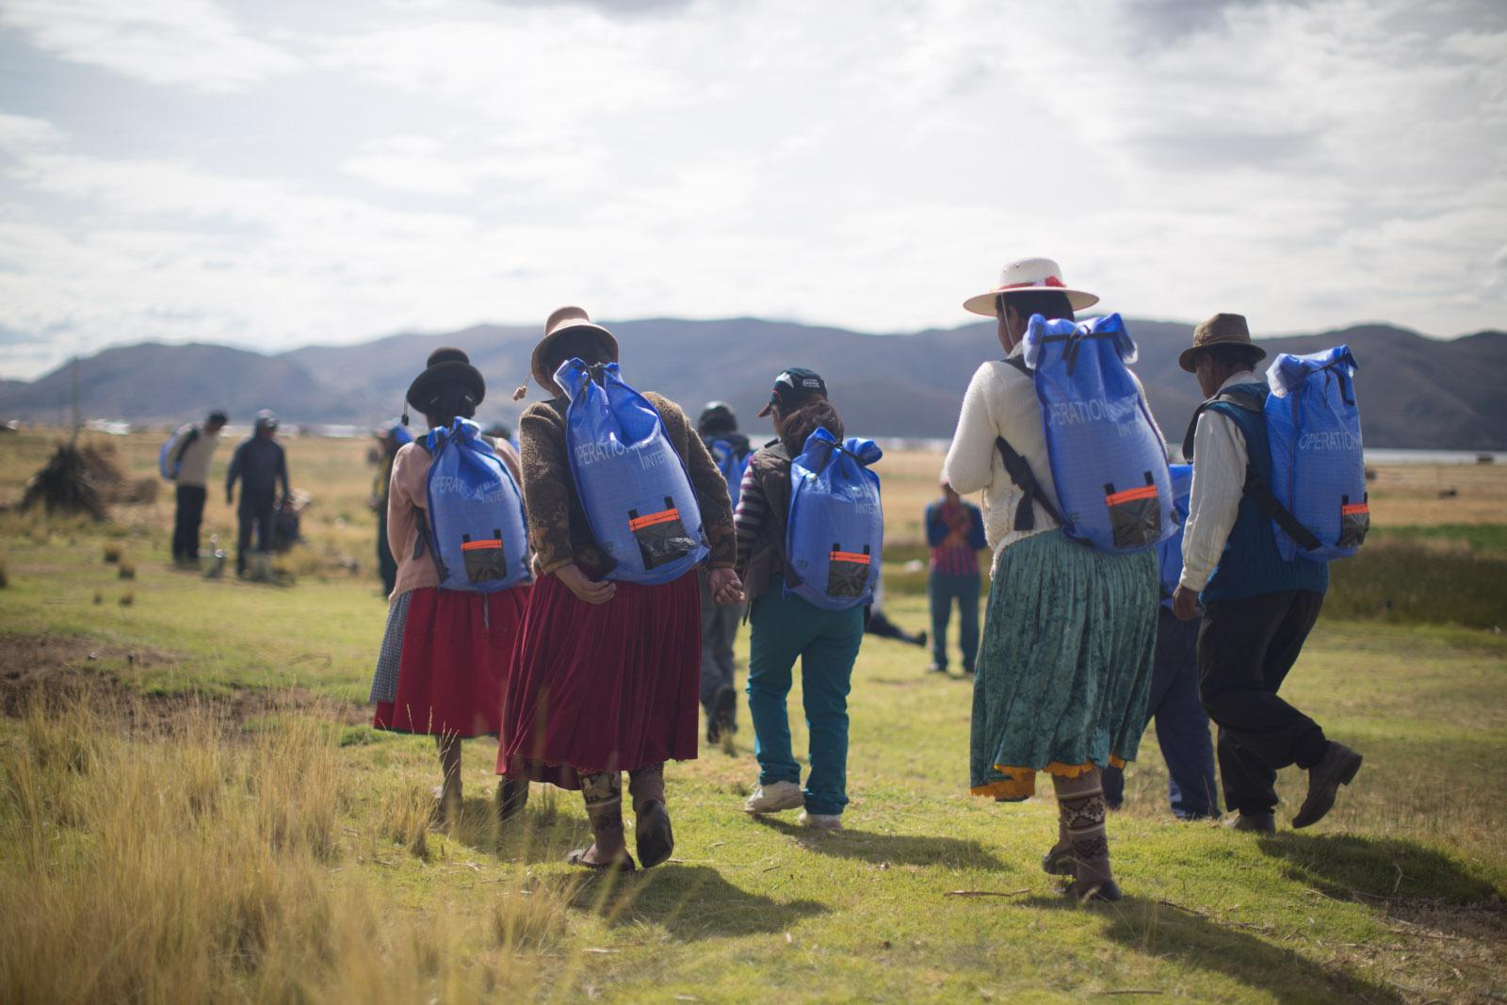
THE SOLUTION TO SAFE WATER TRANSPORTATION

Slide 12
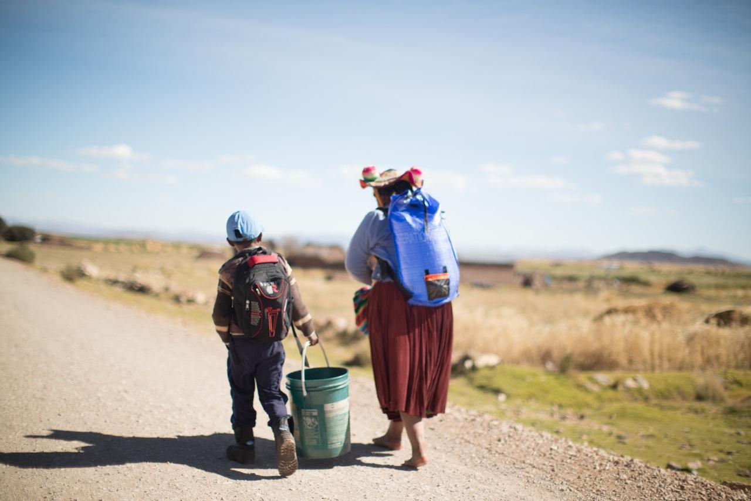
Changing the Path
PackH₂O is a valuable tool for women at the base of the economic pyramid.
Image © Tony Cece

Slide 13
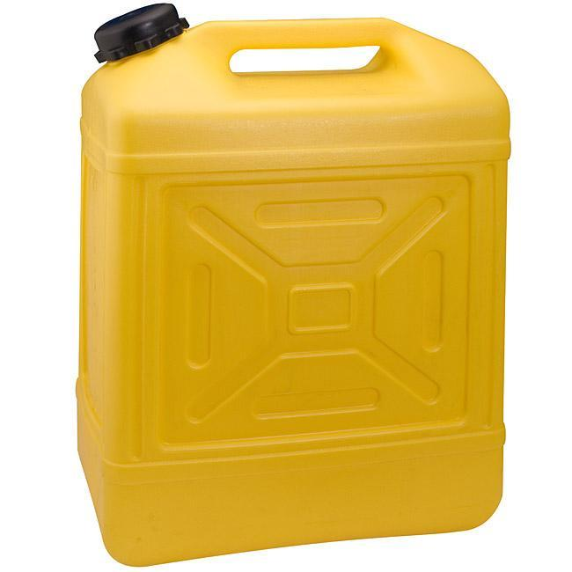
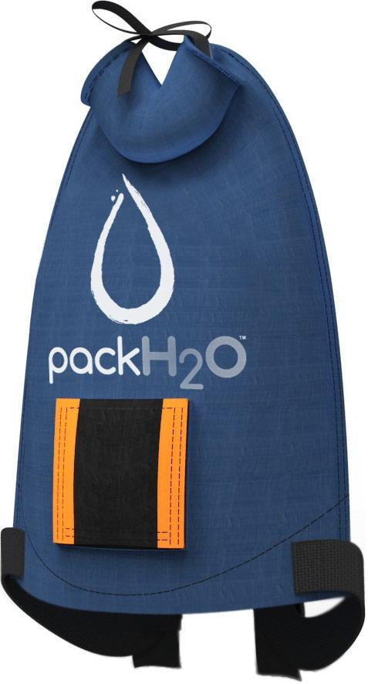
Scientifically Tested
Leading scientific research nonprofit Battelle compared jerry cans vs. PackH₂O for water purity. Conclusion: PackH₂O is a safer alternative.
99% of pathogens and germs eradicated when the backpack liner is placed in the sun for 6O-9O minutes
vs.
SODIS (solar disinfectant method) of liner nearly as effective as chlorination
Notes:
Tony’s notes-I like this slide but I’m worried about showing a clean jerry can when Greif makes 25% of the world’s jerry cans. Can we swap out the clean/yellow can for a dirty one?

Slide 14
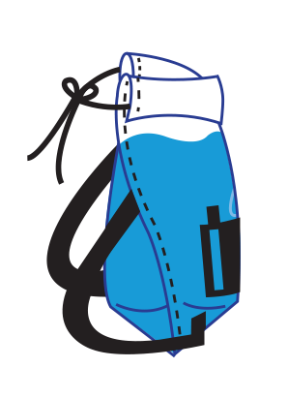
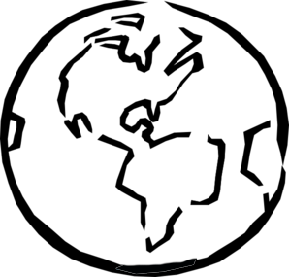
ONE MILLION PEOPLE IMPACTED
200,000 PACKS DELIVERED
50 PARTNERS ENGAGED
35 COUNTRIES TOUCHED

Slide 15
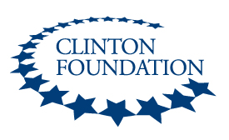
PackH₂O Works in Partnership
Notes:
LOGOS

Slide 16
Recognized for Innovation
Notes:
Tony’s notes-Aysu, Are there any other awards that we should be referencing?

Slide 17
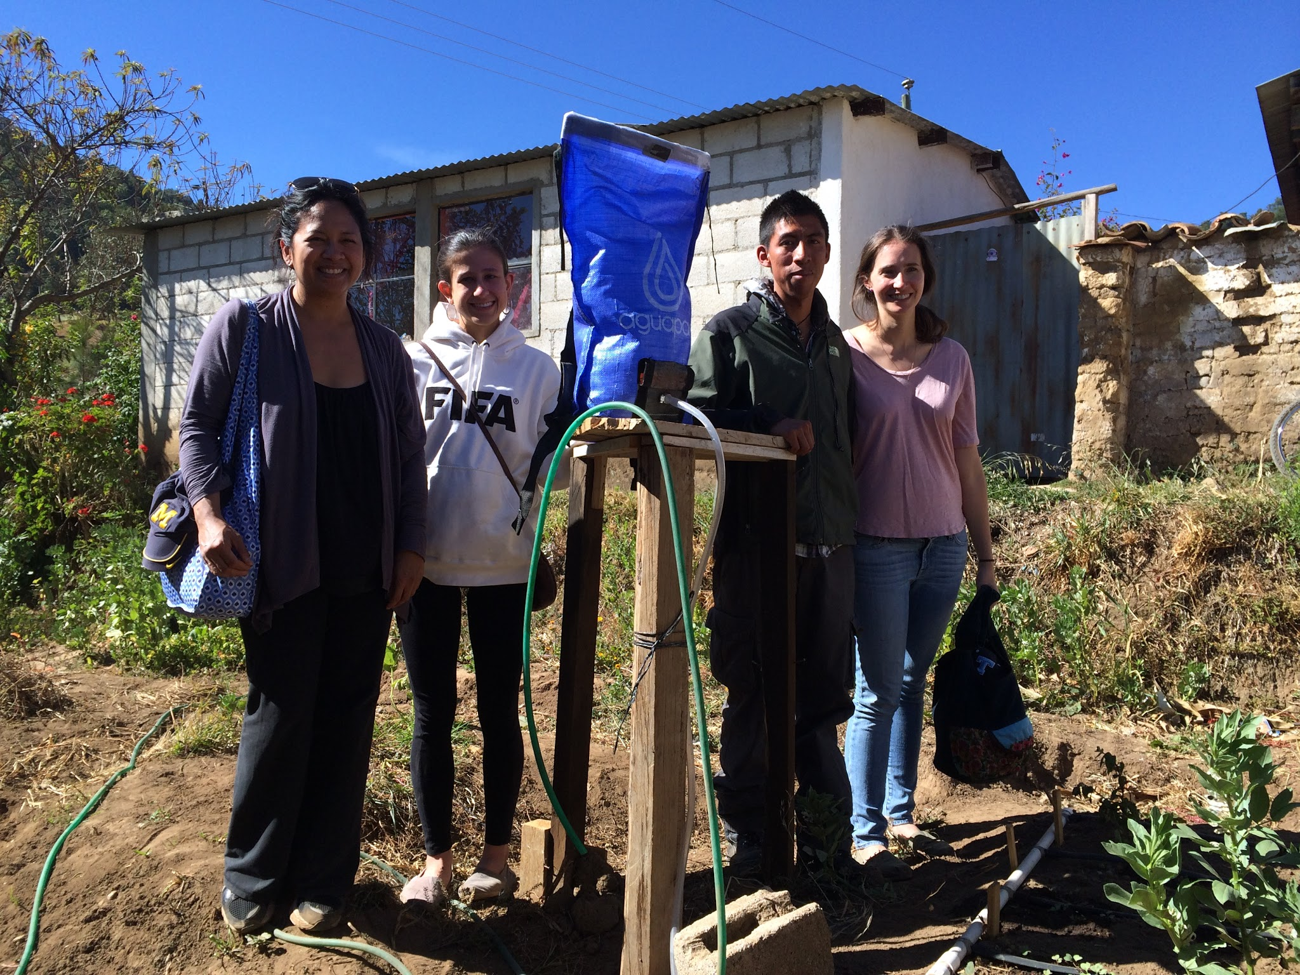
Creating Jobs for Micro-Entrepreneurs
Once established as a commodity within a local water supply chain, the sales and distribution of PackH₂O can become a micro-business opportunity for the same women who once hauled water in open cans.
Image © Partners for Care
Notes:
Tony’s notes-add the word “opportunity” after “micro-finance”

Slide 18
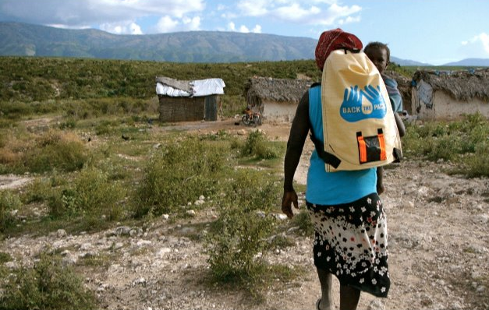
Post DISASTER
PackH₂O is a long-term solution in the global water crisis that provides safe transportation and safe storage of water during – and after– a disaster.
Image © PackH₂0
Notes:
Tony’s notes-I might suggest changing “clean” to “safe”

Slide 19
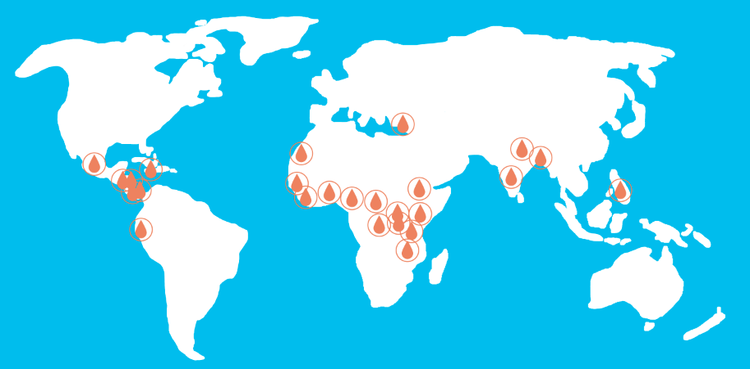
PACK LOCATIONS
35+ COUNTRIES
35
Notes:
Tony’s notes-I would recommend using Calvin’s/Tony’s slide here. I would only focus on # of countries where the pack is. 35+ countries is a good number.

Slide 21
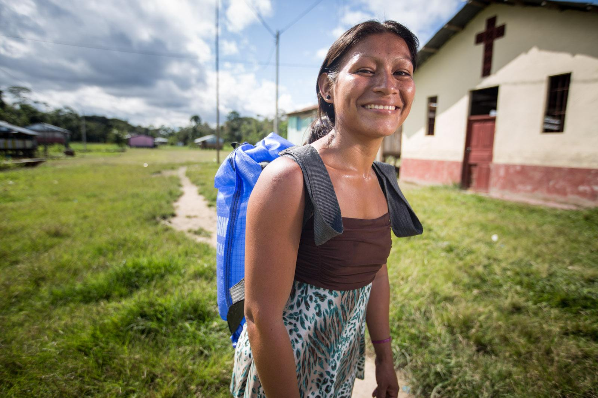
THANK YOU
Eduardo Simoniello
Vice President & General Manager
Greif Latin America
Eduardo.Simoniello@greif.com
INFO@PACKH2O.COM
WWW.PACKH2O.COM
Image © Tony Cece

