Slide 1
Global Summit 2015
May/2015
Notes:
For information on applying this template onto existing presentations, refer to the notes on slide 2 of this presentation.
The Input area of the Beam can be customized to reflect the content of the presentation. The Input area is an AutoShape with a picture fill. To change this, ensure you have the image you wish to use (ideally a .jpg or a .png file) in an accessible folder. The image should have a ratio of 1:1 to ensure it does not appear distorted.
Acceptable images for importing into the Input area of the Beam are the three approved graphics (lines), and black and white photography or illustrations which follow the principles laid out on The Branding Zone. Color images should never be imported into this area.
To create a thank you slide with a picture in the Input area of the Beam, duplicate this master slide and create a new master slide. If using the graphic on the title slide the same should be used on the thank you slide. If using a picture in the Input area of the Beam in the title slide, the same or different but related picture can be used on the thank you slide.
Customize the Input area of the Beam as described below.
Click on the View tab from the menu bar and select Master>Slide Master
Right-click on the Input graphic and select Format AutoShape
From the Fill menu, under the Color and Lines tab, click on the drop-down arrow next to Color and select the Fill Effects menu
From the Picture tab, click on Select Picture. Navigate to the folder containing the image you wish to insert in the Input area. Highlight the image and tick the Lock picture aspect ratio box. Click on OK.
You can now preview the image before continuing. If you are happy with how it looks, click Ok to continue. Otherwise, repeat the process until you are happy with your selected image
To exit from Master View, click on View>Normal. The change you made to the Input graphic should now be visible on the title slide

Slide 2
Global efforts in fighting corruption
Current Scenario

Slide 3
3
THE PHENOMENON OF CORRUPTION:
WHAT IN ENTAILS?
Corruption distorts competition
Establishes forms of unfair competition
Deteriorates the free market mechanisms
Creates uncertainty in the business
Scares away new investments
More expensive products and services
Destroys business ethics
Undermine sustainable development of the markets
Removes any possibility of consistent profitability in the long run.
Grupo de trabalho do pacto empresarial pela integridade contra a corrupção. Controladoria Geral da União – CGU. Instituto Ethos de empresas e responsabilidade social. www.cgu.gov.

Slide 4
CPI – Corruption Perceptions Index 2014
Transparency Internacional

Slide 5
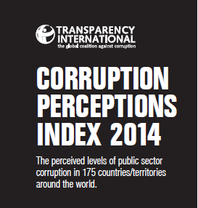
5
CORRUPTION PERCEPTIONS INDEX
175 COUNTRIES.
175 SCORES.
HOW DOES YOUR COUNTRY MEASURE UP?
The perceived levels of public sector corruption in 175 countries/territories around the world.
www.transparency.org

Slide 6
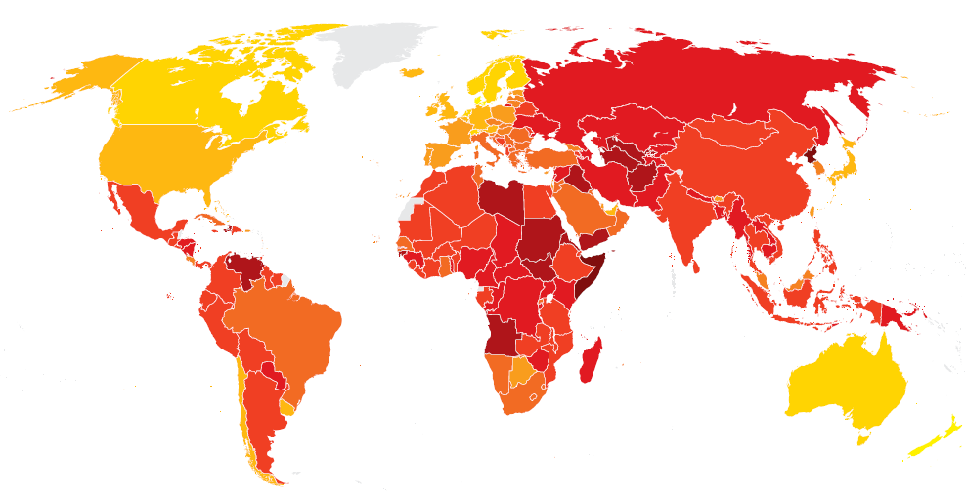
6
CORRUPTION PERCEPTIONS INDEX
RUSSIA: 27 = 136/175
2013: 28
DEINMARK: 92 = 1/175
2013: 91
CHINA: 36 = 100/175
2012: 40
Canada: 81 = 10/175
2013: 81
United States: 74 = 17/175
2013: 73
Mexico: 35 = 103/175
2013: 34
NORTH KOREA: 8 = 174/175
2013: 8
Columbia: 37 = 94/175
2013: 36
Venezuela: 20 = 161/175
2013: 20
Ecuador: 33 = 110/175
2013: 35
INDIA: 38 = 85/175
2013: 36
Peru: 38 = 85/175
2013: 38
BRAZIL: 43 = 69/175
2013: 42
Bolivia: 35 = 103/175
2013: 34
SOMALIA: 8 = 174/175
2013: 8
Paraguay: 24 = 150/175
2013: 24
Uruguay: 73 = 21/175
2013: 73
Chile: 73 = 21/175
2013: 71
Argentina: 34 = 107/175
2013: 34
SOUTH AFRICA: 44 = 67/175
2012: 42
CORRUPTION - “BRICS”

Slide 7
Brazil country focus

Slide 8
8
CORRUPTION – CONTEXT:
OVERVIEW AND RISKS FOR THE COMPANIES
Biddings?
Government funding / Public Contracts?
Licenses and Permits?
Suppliers?
Brokers?
High-risk Government contracts?
Consultants/Advisory? Law Firms?
Business courtesies?
Sponsorships and donations?
Companies at the same industry under investigations by national and/or foreign Authorities?

Slide 9
Brazilian Anti-Corruption Law
(Law no.12.846/13)
The Clean Companies Act

Slide 10
10
BRAZILIAN ANTI-CORRUPTION LAW – MAIN FEATURES
Efective: 01/29/2014
Objective: Civil and Administrative responsibility of legal entities practicing harmful acts against the public administration – national or foreigner.
Companies will be punished by the public administration regardless of a final judicial decision. The possibility of disregard of the legal entity in the administrative process to apply sanctions on managers and executives is foreseen.
Sanctions: Very severe
Administrative | Judicial
Penalties from 0.1% to 20% of company’s gross revenue for the previous year; R$ 6k to R$ 60 MM (if not possible to use revenue criteria) Extraordinary publishing of the courts sentence decision. | Prohibition to receive incentives, subsidies, grants, donations or loans from public bodies or entities (1 to 5 years) Seizure and confiscation of assets and disgorgement of gains; Partial suspension or complete cessation of its activities; Compulsory dissolution of the legal entity

Slide 11
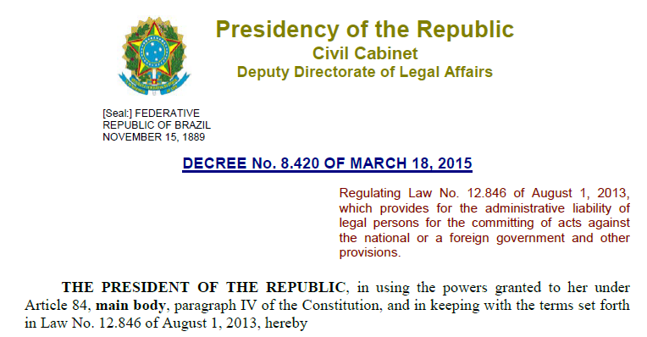
11
BRAZILIAN FEDERAL DECREE 8,420/2015
Companies must put focus and investment in Corporate Governance and in its Compliance Program to achieve sustainable results
Compliance as a competitive advantage

Slide 12
How companies can establish or improve their Corporate Governance and Compliance structure?

Slide 13
13
COMPLIANCE PROGRAM – LIFECYCLE AND STRUCTURING
PREVENT / DETECT / RESPOND
Risk Assessment
Periodic Program review
Top Management
Due
Diligence
Policies and Internal Controls
Investigation and report (Helpline)
Communication and Training
Monitoring and Auditing

Slide 14
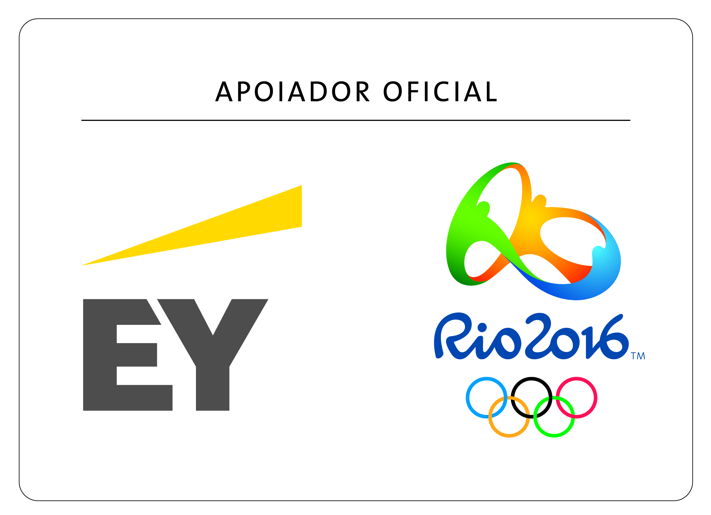
14
EY | Assurance | Tax | Transactions | Advisory
About EY
EY is a global leader on Assurance, Tax, Transactions and Advisory services. Our insights and quality services which we provide help the trust creation in the capital markets and in the economies around the world. We develop outstanding leaders who work with the team to meet our commitments to all the stakeholders. Thus, we perform an essential role on building a better business world to our people, our clients and our communities.
At Brazil, EY is the most complete company providing Assurance, Tax, Transactions and Advisory services, counting with 5,000 professionals to support and serve more than 3,400 clients from small, medium, and large businesses,
In 2012, EY Brazil has become the Official Supporter to Olympic Games Rio 2016TM and the sole provider of consultancy service to the Organizing Committee. The alignment of the Olympic Movement values and EY values has been decisive in this initiative.
EY refers to the global organization, and may refer to one or more, of the member firms of Ernst & Young Global Limited (EYG), each of which is a separate legal entity. Ernst & Young Global Limited, a UK company limited by guarantee, does not provide services to clients. For more information about our organization, go to ey.com.br.
© 2013 EYGM Limited. All rights reserved.
www.ey.com.br
Thank you!

