Slide 1

Vania Curiati
Diretora
Business Partner Brazil
Experience in Motion
Design in Motion
Business in Motion Design in Motion
Design in Motion
Experience in Motion
Business in Motion Experience in Motion

Slide 2
Vania Curiati
Diretora
Business Partner Brazil
Experience in Motion
Design in Motion
Ana Paula Assis
Alejandro Padron
Vice President
Software Group Brazil
LA Retail Leader
Industry Solutions
Felipe Peñaranda
LA Security Tiger Team Leader

Slide 3
Ana Paula Assis
Vice President
Software Group Brazil
Experience in Motion
Design in Motion
Business in Motion Design in Motion
Design in Motion
Experience in Motion
Business in Motion Experience in Motion

Slide 4


Mobile drives exponential data growth, creating new opportunities
By the year 2020 …
4xmore digital data than all the grains of sand on earth
Machine generated data will be
42% of all data
There will be
over 12 billion
machine devices
There will be
over 200 billion
connected devices

Slide 5

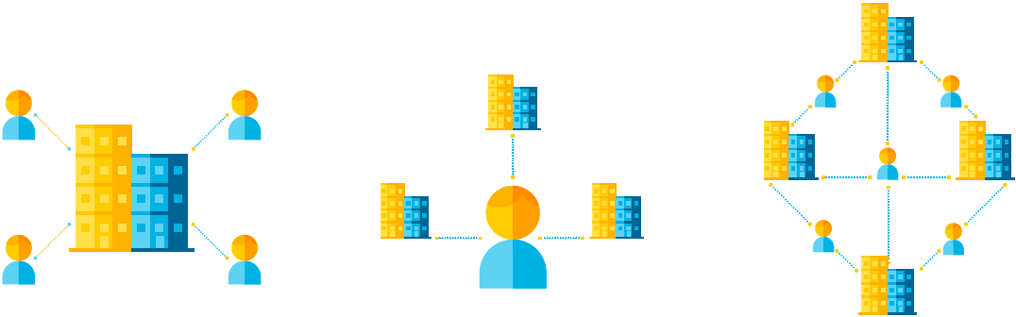

Hyper-connected environment…
The everyone-to-everyone economy
Organization- centered economy
Individual-centered economy
E2E
Economy
© 2015 IBM Corporation
Source: “Digital Reinvention: Preparing for a very different tomorrow.” IBM Institute for Business Value. December 2013.
5

Slide 6
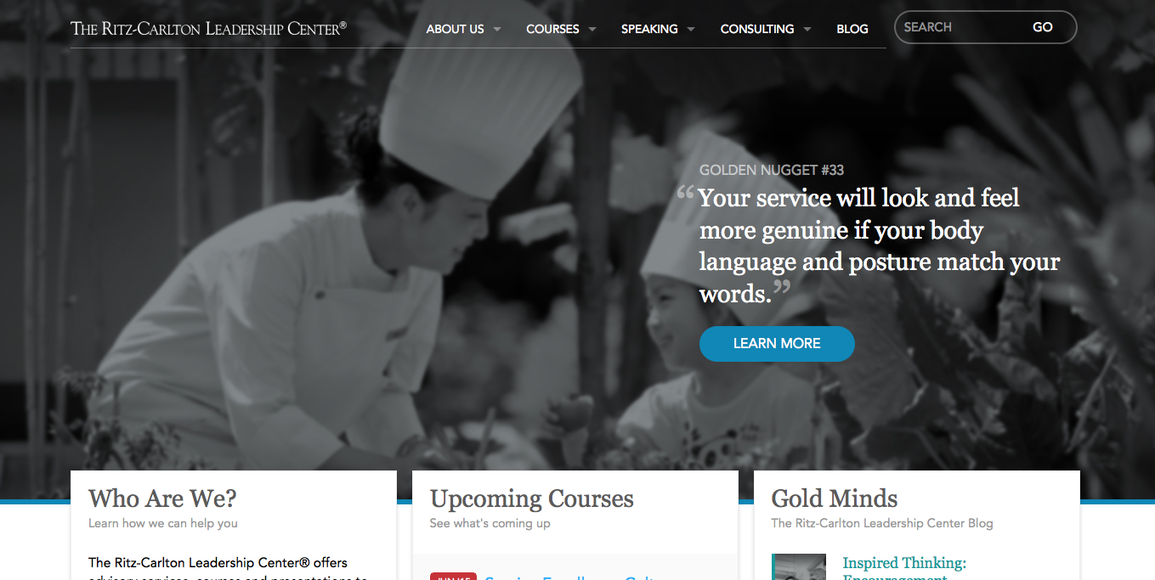

Slide 7

“In the next five years when you look at the South African banking and telecommunications industries, I think you will see some mergers and acquisitions. It will be interesting in the next 5 years how these two worlds converge,” Stafford Massie, chief executive officer and founder of the payment technology innovations company, Thumbzup.

Slide 8

House of Cards
Hemlock Grove
Orange Is the New Black
Start Your Free Month

Slide 9

Apple App Store – a great example of the emergence of new ecosystem

Slide 10
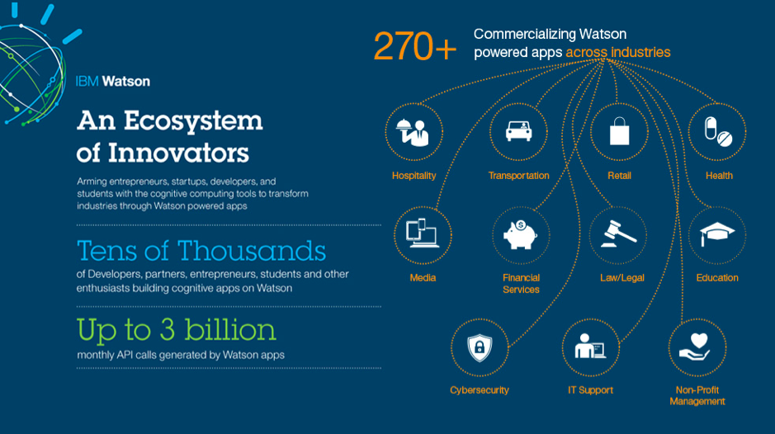

Slide 11
The
economy will be orchestrated,
symbiotic, contextual and cognitive
Orchestrated
  The ecosystem is collaborative and seamless
Everyone to everyone
Cognitive
Symbiotic
  Self-supported learning and predictive capabilities
  Everyone and everything is mutually inter-dependent
Contextual
  Experience is calibrated and relevant to actions and needs

Slide 12
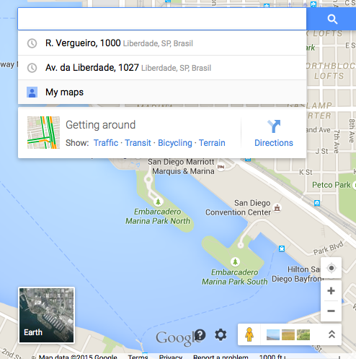
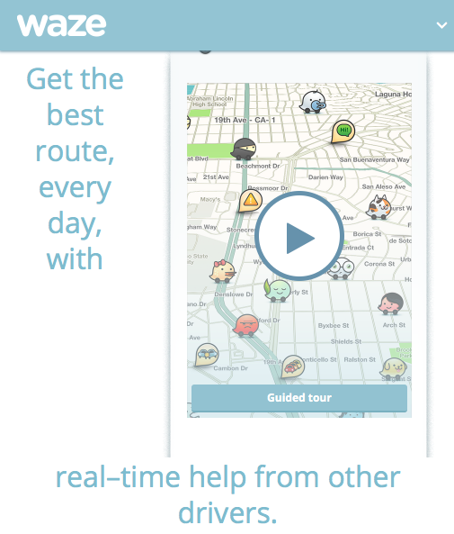
Connectivity Orchestrated

Slide 13
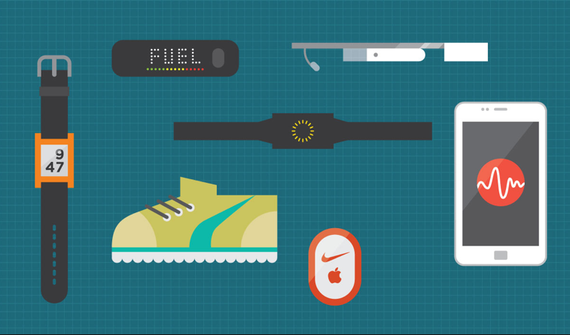
Interactivity Symbiotic

Slide 14

Awareness Contextual

Slide 15
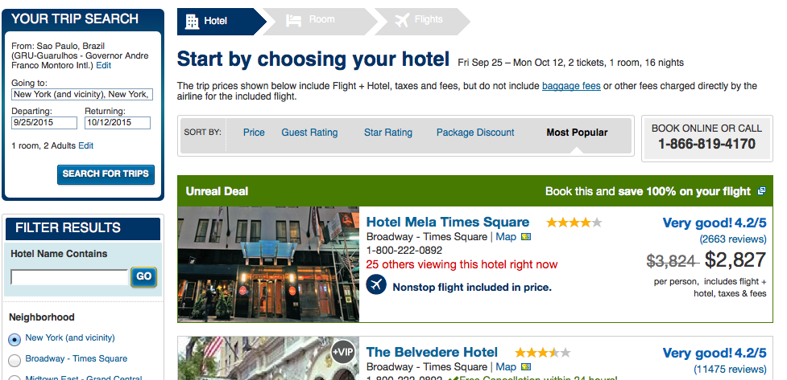

Slide 16


Ana’s Travel App
From
GRU – Sao Paulo Intl Airp
To
Departure
JFK – New York Intl Airp
Sep 26 2015
Return
Oct 12 2015

Slide 17
Ana’s Travel App
Are you going to the New York Film Festival at Lincoln Center?
Yes.
So, here are two great hotels in the area. Most of the directors and producers will be staying at the Empire Hotel. Actors are staying at the Hudson New York. Which one do you prefer?
The Empire
Ok. I booked one non-smoking room, king bed size for you.

Slide 18
Ana’s Travel App
On Sep 27th a big group of attendees is booked to have dinner at Atlantic Grill, would like me to go ahead and book a table for you at 8:00pm?
No. I’m in the mood for Italian. What would you recommend?
The two highest recommended
ones are Bambino and Gianpiero.
Which one would you like?
Which one
Is the best?

Slide 19
Ana’s Travel App
Based on your prefences, Giampietro.
Ok. Can you book please?
Restaurant is booked for Sep 27 2016.
Intelligence Cognitive

Slide 20
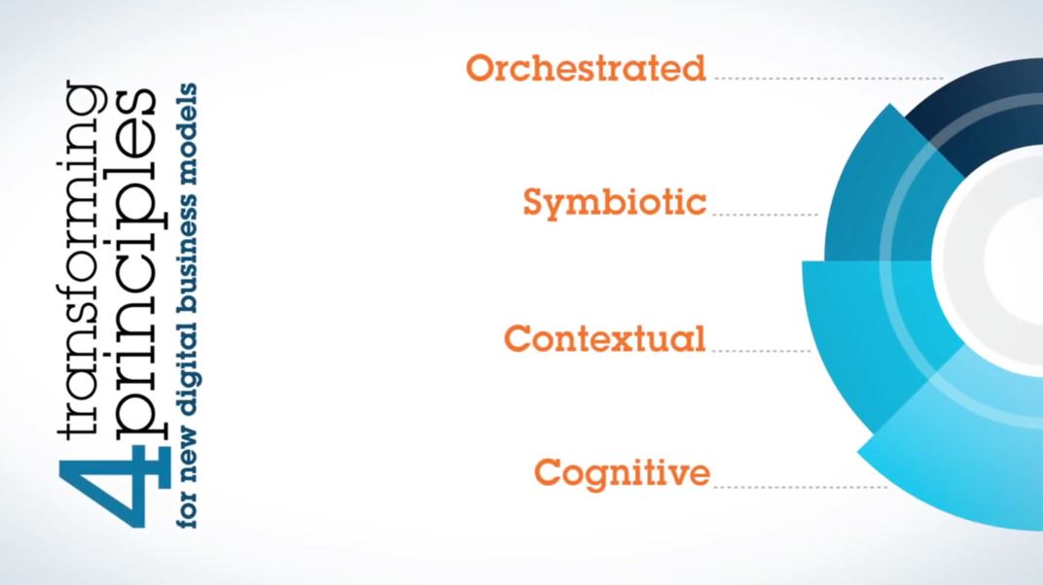

Slide 21
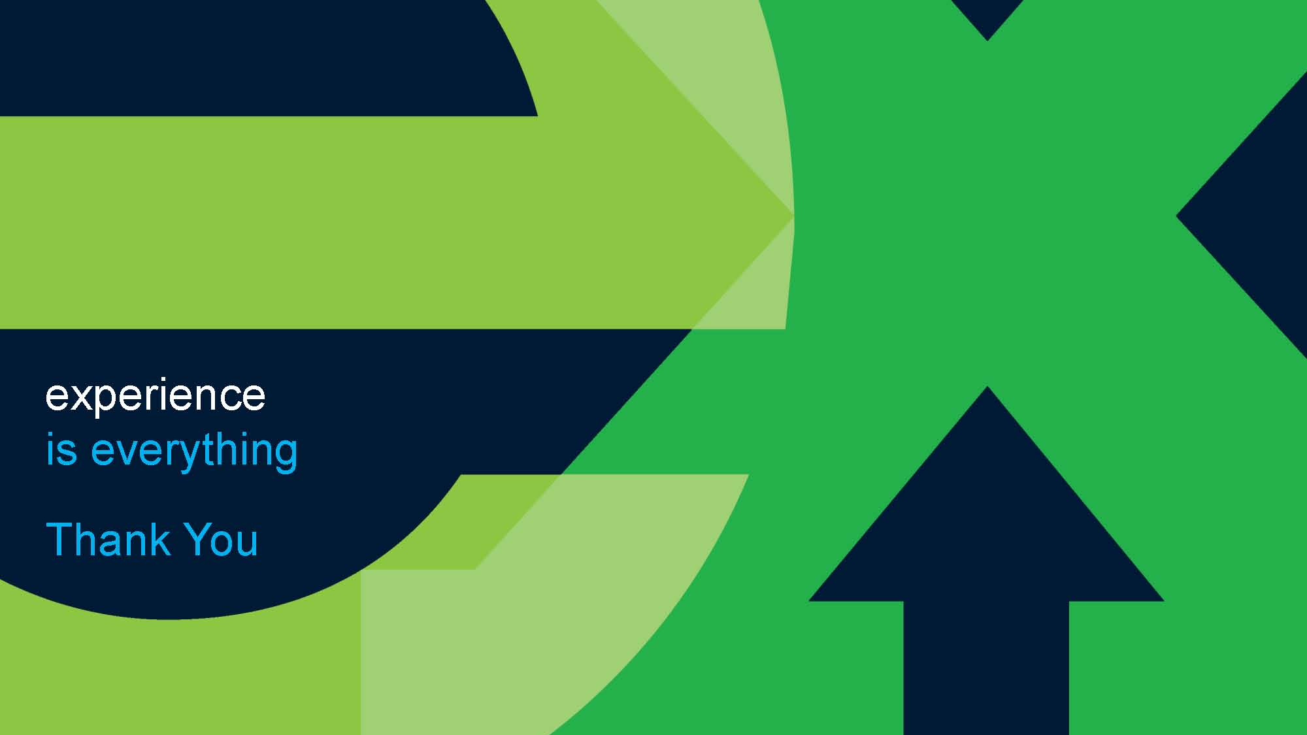
experience
is everything
Thank you!

Slide 22
Alejandro Padron
LA Retail Leader
Industry Solutions
Experience in Motion
Contextual
Contextual Contextual
Contextual
Contextual
Contextual Contextual

Slide 23
Shoppers Disrupted

Slide 24
Customers expect a personalised approach
Make it convenient and easy to interact with you
Be there when I need you, in real time
Remember all of my interactions
Anticipate and service my shopping needs
24
24

Slide 25




Retailers must embrace change, find new ways to understand,
engage and fulfill on consumer demand
Engage in
Context
Seamless
Shopping
Innovate, transform
experiment
Protect and
leverage data
25
25

Slide 26
Industry statistics confirm these mega-trends:
60%
26B
Shoppers want to check inventory avail before going to store
Devices in the IoT by 2020
54%
82%
Consumers see the benefit of sharing mobile for text with retailers
Greater multi-channel consumers spend than single-channel shoppers
26
26

Slide 27
These mega-trends are creating opportunities…
And unprecedented challenges for our industry
Mobile and Social morph, benefit from the Internet of Things (IoT)
New business - and financial - models
Science goes mainstream
Security & Privacy
Discretionary spend decisions
27
27

Slide 28


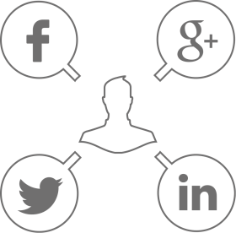

Determining the dimension of the problem:
What is important to know about a customer?
Food
Behavior
Community
Conscious
Beverage
Behavior
Event
Drivers
Message
Relevance
External
Competitors
Transaction data
Influence
External Forces
Rewards
Program
Influence
Weather
Enterprise
In-Store
Experience
My Media Channel Preferences
Characteristics
Employee
Influence
Customer
My Day Part
My Finances
My Need State
My Occupation
My Lifestyle/
Demographics
Social Listening
Lifestyle / Demographics
28
28

Slide 29






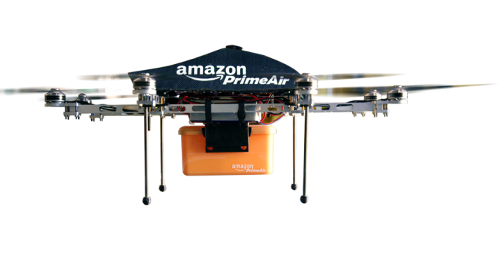

The Disruptors cause the huge paradigm shift:
29
29

Slide 30

30

Slide 31
experience
is everything
Thank you!

Slide 32
Felipe Peñaranda
LA Security Tiger Team Leader
Experience in Motion
Security Intelligence
Security Intelligence Security Intelligence
Security Intelligence
Security Intelligence
Security Intelligence Security Intelligence

Slide 33


Clients are facing new security challenges, with advanced threats emerging continually, putting their business and brand at risk
Business results
Brand image
Data breach
Fraud
Impact of hacktivism
Audit risk
After its recent data breach, a retailer reported US$148M¹ in data breach-related expenses, but executives estimate a total cost of US$1 to US2B²
  The retailer also suffered major brand damage after the breach, falling from a consistent top 10 to number 21 in the 2013 Brand Index rankings³
There were 253 large-scale data breaches globally in 2013, a 62 percent rise from 2012. And eight of these exposed more than 10 million identities each⁴
After stealing customer data on over 600,000 customers of a US-based company in Europe, hackers demanded ransom to not publish the information⁵
Anonymous Brazil, through a series of DDoS⁶ and web site defacement attacks, protested the social injustice surrounding the World Cup 2014⁷
  A major medical center and hospital were jointly fined US$4.8M for a data breach that compromised patient health records⁸
US $5.85M
average cost of a data breach
average cost of a lost or stolen record⁹
US $201
1) New York Times, August 5, 2014; 2) International Business Times May 5, 2014; 3) CBS MoneyWatch Jan 2014; 4) Symantec report: Latin American and Caribbean CyberSecurity Trends June 2014; 5) Reuters June 16, 2014; 6) DDoS stands for Distributed Denial of Service; 7) InfoSec Institute; Forbes, June 18, 2014; 8) McCann, Healthcare IT News, May 8, 2014; 9) Cost of Data Breach, Ponemon Institute
How do you know if your security organization is prepared to handle the next threat?
33
33

Slide 34
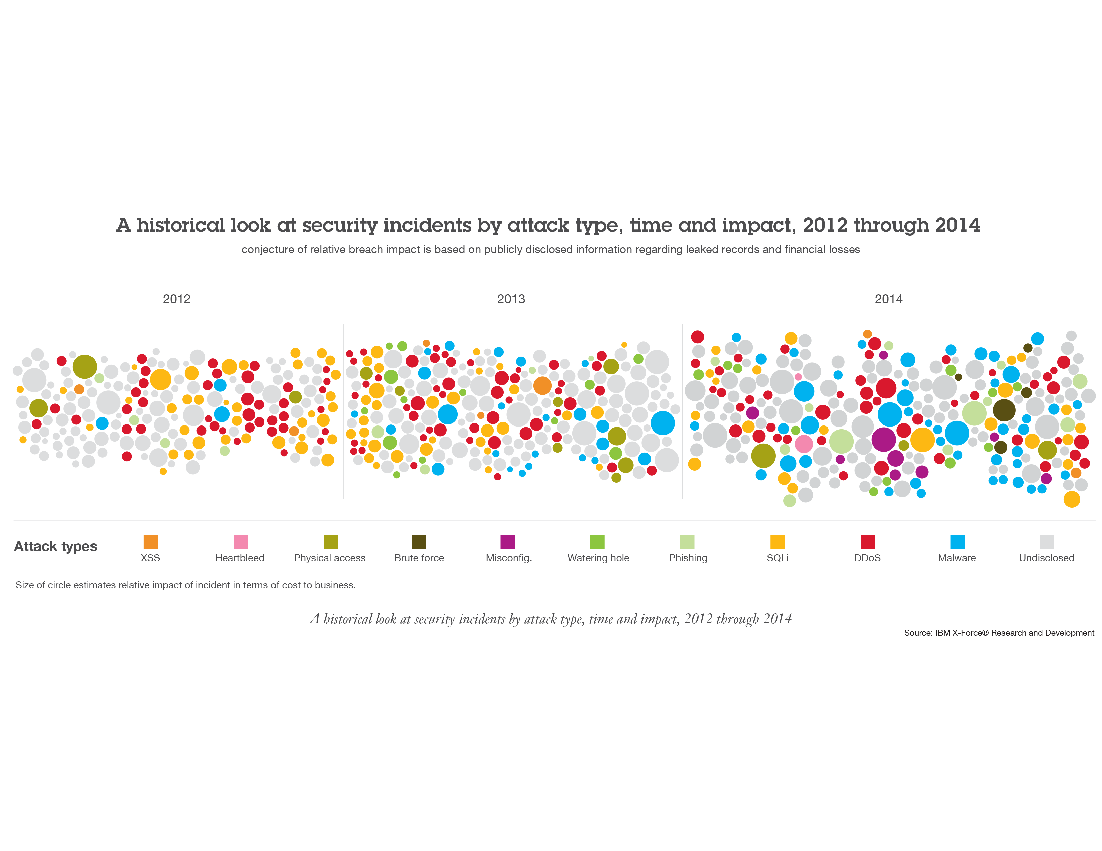
83% of CISOs say that the challenge posed by external threats has increased in the last three years
Near Daily Leaks
of Sensitive Data
40% increase
in reported data
breaches and incidents
Relentless Use
of Multiple Methods
800,000,000+ records
were leaked, while the future
shows no sign of change
“Insane” Amounts of Records Breached
42% of CISOs
claim the risk from external threats increased dramatically from prior years.
Source: IBM X-Force Threat Intelligence Quarterly – 1Q 2015 and 2014 IBM Chief Information Security Officer Assessment
34
Notes:
Note: This graphic, and several others in the report are a preview of the upcoming IBM X-Force Threat Intelligence Quarterly for 1Q, being publishing on March 17, 2015.
In the past three years, the amount of data records and variety of attacks have expanded to epic levels.

Slide 35
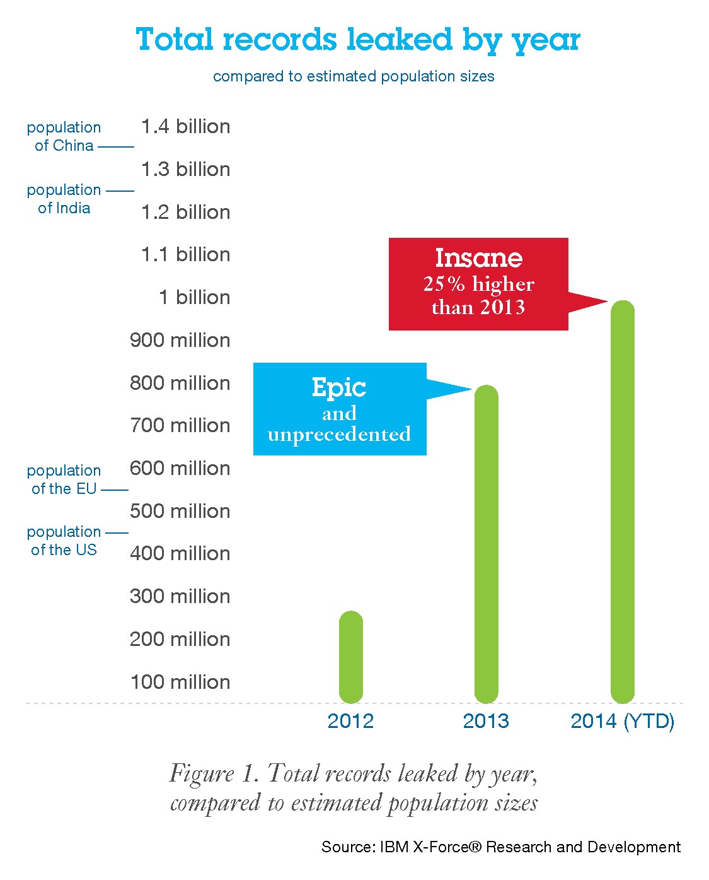
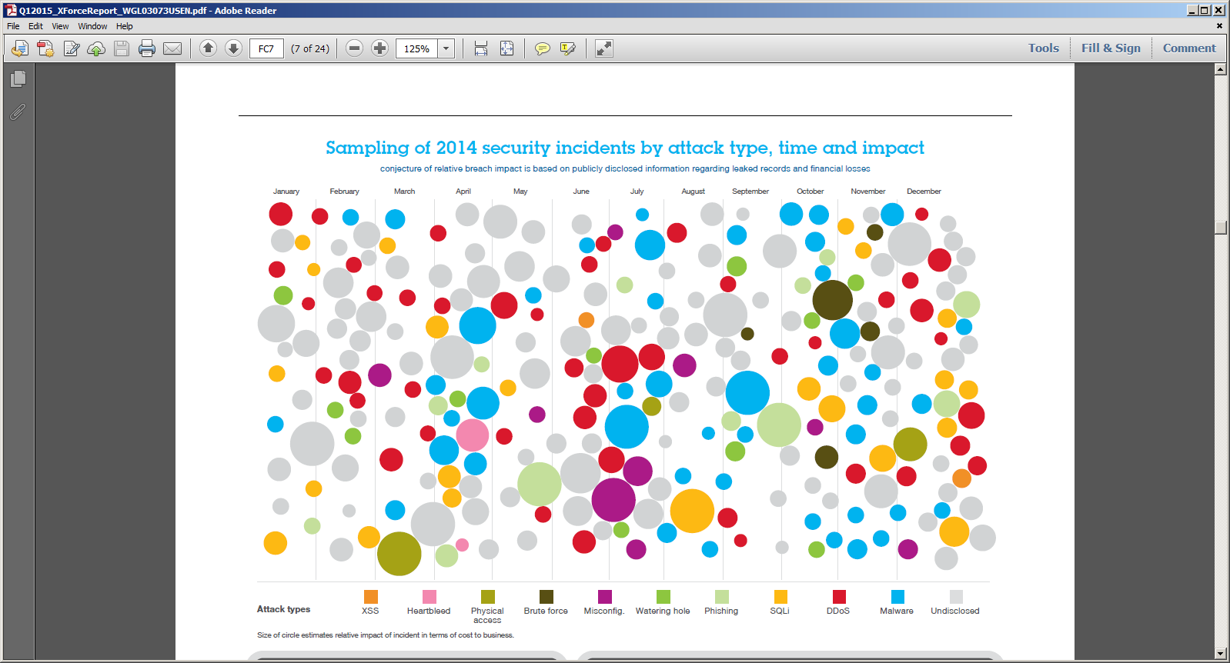
2014: 25% more records leaked than 2013… insane!
Source: IBM X-Force® Threat Intelligence Quarterly, 1Q 2015
35
35

Slide 36

PARADIGM SHIFT
in crime

Slide 37






Sophistication is INCREASING
Attacks are
More Targeted
Attackers are
More Organized
37
Notes:
The sophistication of today’s attackers increasing…
Attacks are becoming more targeted. The attackers look for specific organizations they want to attack, and then find a way to get in – spending months in some cases, as we have just seen with a number of recent situations. They find specific individuals through spear fishing, individuals who may not be in the target organization, but who are way down the supply chain
Attackers themselves are becoming more organized. They are structured just like any other business with a syndicated global management architecture that’s well equipped for global orchestration of the most sinister intent. They work 9 to 5. It’s a job.
We know they are more organized because our researchers in Israel noticed that on Friday evening a whole bunch of malware gets launched. They launch on Friday because they want to take the weekend off. It’s a business.

Slide 38
EVERYONE
in this room
can be a target
38
Notes:
<Stage Production: Spotlights scan the audience.>
Everyone in this room is a target…
The net of this is, everyone in this room is a target. Your systems are at risk, your applications are vulnerable, your devices can be hacked.

Slide 39
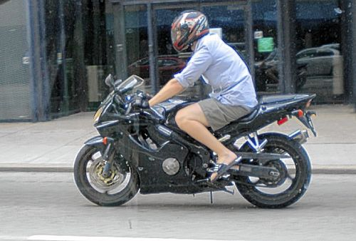

Security is different from Compliance
Compliance
Security
39

Slide 40

Holistic View is mandatory for Security
40

Slide 41
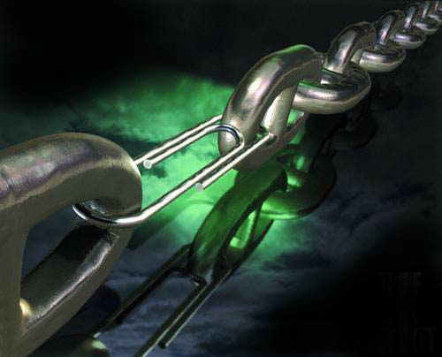
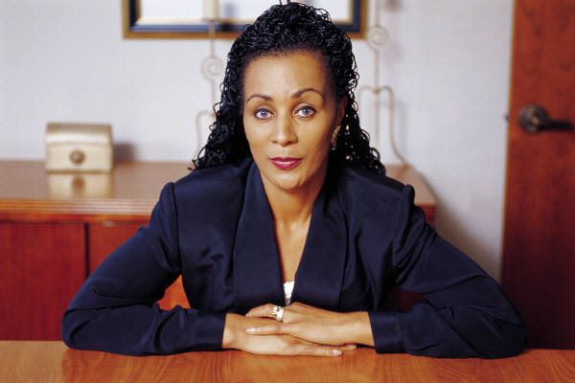
Security is as strong as its weakest link
41

Slide 42




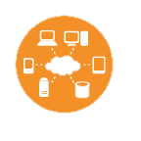
















Based on extensive experience, IBM has outlined 10 essential practices for a stronger security posture
Understand security essentials
3 Secure collaboration in social and mobile workplace
4 Develop security-rich products, by design
5 Manage IT hygienically
6 Create a security-rich and resilient network
1 Build a risk-aware culture and management system
2 Establish intelligent security operations and rapid threat response
7 Address security complexity of cloud and virtualization
8 Manage third-party security compliance
9 Assure data security and privacy
10 Manage the digital identity lifecycle
42

Slide 43
experience
is everything
Thank you!

