Slide 1
Setting Standards for Women´s Economic Participation
Lic. Susana González Lebrija
CEO
Global Summit of Women
Sao Paulo , Brazil, May 15, 2015

Slide 2
Background
In 2003 is launched by the National Institute of Women
In 2009, is developed by the Department of Labor and Social Welfare (STPS), through the Subsecretary of Labor Inclusion obtaining the support of the Federal Government
Latest update in 2012
Equality and Gender Model
Distinctive
NMX-R-025-SCFI-2012
For Labor Equiality between Women and Men Certification
(Third Party Audit)

Slide 3
What is the NMX-R-025-SCFI-2012?
A voluntary certification instrument, unique in its kind:
Audit and review through established guidelines specific practices and indicators of the organization .
Contributes to the fulfillment of several national and international laws and regulations.
It is valid for a period of four years, with a two year follow up audit.
Rated with a total of 284 points, a minimum of 75% or 213 points is required to obtain the Labor Equality Seal.
2

Slide 4
Requirements to be assessed
Labor practices, indicators and actions of a given period.
Evidence of fulfillment of more than 120 requirements
Main focus:
Pillars of the NORM
Equality and non-discrimination
Social welfare
Freedom of labor union association
Working environment
Accessibility and ergonomics
Job postings and offers expressed with a non-sexist language and free of any discriminat0ry expressions.
Explicit prohibition of non-pregnancy certificate as a condition of employment.
Policies, programs and mechanisms to prevent, treat and punish labor and workplace violence.
3

Slide 5
Evaluation Criteria
1. Equality and non-discrimination.- Adoption of policies and actions.
Regulation and organizational formats: Mission, Vision, Regulations, Code of conduct and Organizational plan, structure and chart;
Recruitment and selection;
Employment stability: layoffs, seniority and maternity leave;
Salaries, incentives and equal compensation for work of equal value and free from discrimination;
Vertical and horizontal mobility.
2. Social welfare.- Enjoy benefits and compensations without any discrimination, as well as schemes and mechanisms to balance between family and work life.
Education and training
Flexible hours / Home office
Breastfeeding practices
4

Slide 6
Evaluation Criteria
Working Environment.- Practices and indicators of a free violance and sexual harassment workplace. The satisfaction of workers is measured in the workplace, through the application of an instrument of labor-partner perception.
Establishment and dissemination policy;
Complaint mechanism;
Trained staff to handle situations.
Accessibility and ergonomics.- Physical spaces and furniture adapted to the needs of pregnant women, people with disabilities and seniors.
Existence of infrastructure support for breastfeeding;
Bathrooms, adequate and proportionate to the staff members.
Freedom of labor union association.- Respect the right of workers to
form and join labor unions.
Union autonomy
Freedom of negotiation
6. Additional Points
5
Notes:
Mencionar otros distintivos, buenas prácticas,

Slide 7
Evaluation Procedure
Audit request
Analysis and diagnosis: Indicators and critical points
Audit Planning
On-site evaluation
Results delivering
Certificate is delivered if the audit is successfully approved

Slide 8
Evaluation Results
Promote actions in favor of the company and staff
What have we found ? Positive and negative results / challenges
Resistance to change
Improvised documents
Lack of organizational communication channel
Implementation of best practices (Canteens and food services, milk feeders
and agreements with nurseries).
Organizational impact
Improved working environment
Training courses
Changes in infrastructure
Certified organizations and work places: 2009 - 2015: 2,345, benefiting a total of
151,088 people; 46% women and 54% man.
Follow up: Surveillance Audit

Slide 9
Benefits
For Organizations
For Staff
Decreased staff turnover
Increased productivity
Social recognition for their commitment to human development and decent work
Commitment to global trends in human resources
Humanization of companies
Use of the Seal "Labor Equality between Women and Men" in their products or campaigns
Additional score in government bidding process
Training programs according to the employee's duties
Practices that benefit the balance between work and personal life
Increase of Labor certainty
Working environment improvement

Slide 10
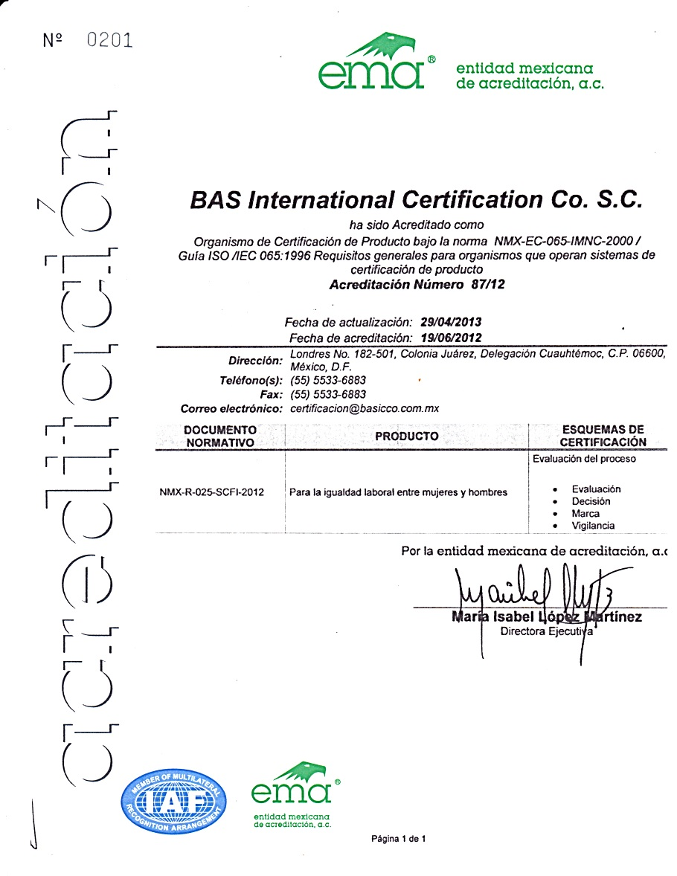
International Scope
The certification granted by Basicco, has an international reach, since this Product Certification Body is accredited by the Mexican Accreditation Entity (EMA), which have signed a multilateral agreement with the International Accreditation Forum (IAF) .

Slide 11
GRACIAS – THANKS- OBRIGADO
LIC. SUSANA GONZÁLEZ LEBRIJA
E mail: direccion_basicco@hotmail.com
gonzalez.su@gmail.com

